Slide 1
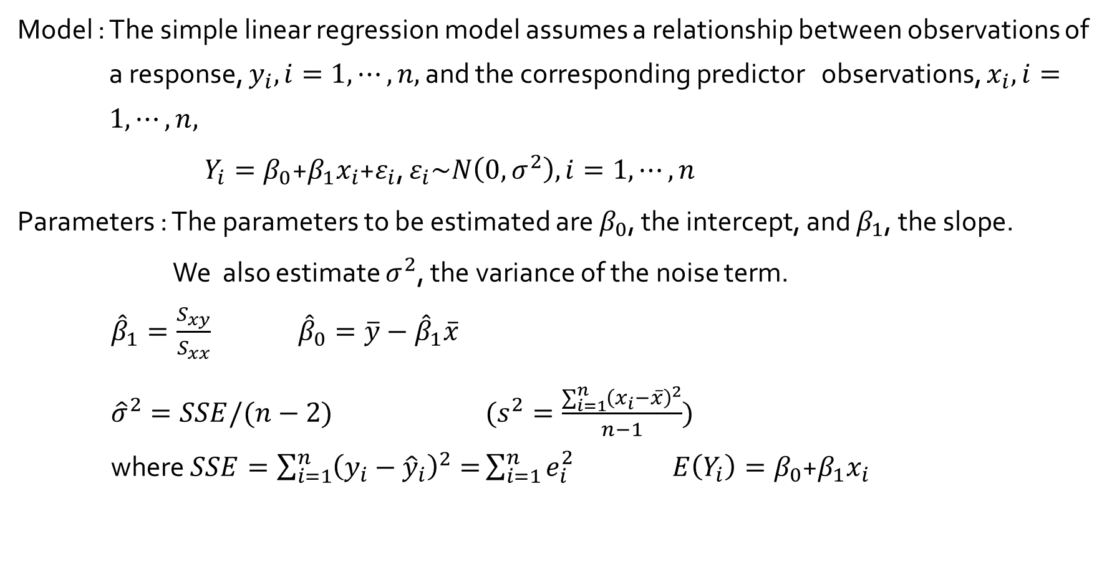
Simple Linear Regression
Model : The simple linear regression model assumes a relationship between observations of a response, $y_{i}, i=1, ⋯, n,$ and the corresponding predictor observations, $x_{i}, i=1, ⋯, n,$
$Y_{i}=β_{0}$+$β_{1}x_{i}$+$ε_{i}$, $ε_{i}\sim N\left(0, σ^{2}\right), i=1, ⋯, n$
Parameters : The parameters to be estimated are $β_{0}$, the intercept, and $β_{1}$, the slope.
We also estimate $σ^{2}$, the variance of the noise term.
${\hat{β}}_{1}=\frac{S_{xy}}{S_{xx}}$ ${\hat{β}}_{0}=\overline{y}−{\hat{β}}_{1}\overline{x}$
${\hat{σ}}^{2}=SSE/(n−2)$ ($s^{2}=\frac{\sum_{i=1}^{n}{{\left(x_{i}−\overline{x}\right)}^{2}}}{n−1}$)
where $SSE=\sum_{i=1}^{n}{{\left(y_{i}−{\hat{y}}_{i}\right)}^{2}=}\sum_{i=1}^{n}{e_{i}^{2}}$ $E\left(Y_{i}\right)=β_{0}$+$β_{1}x_{i}$

Slide 2
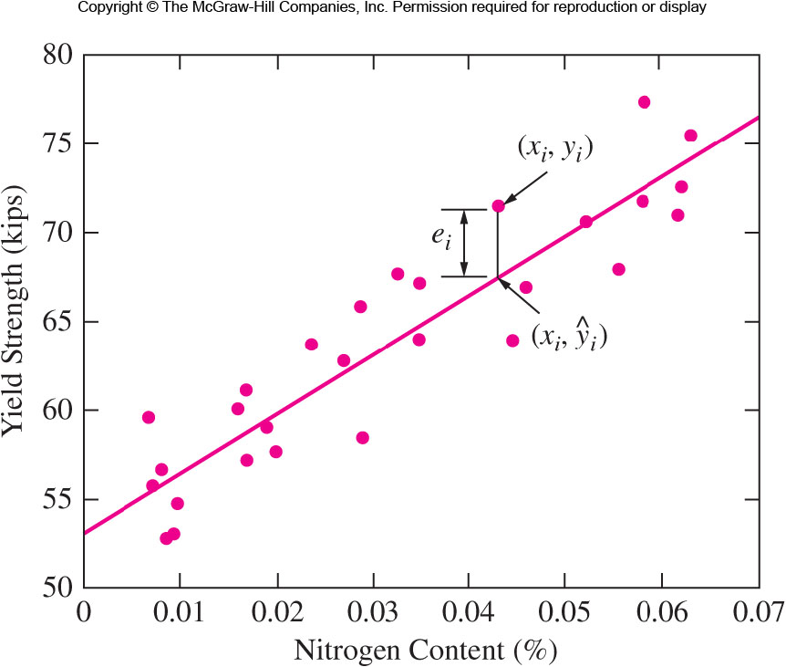


Figure 2.7 Yield strength versus nitrogen content for a sample of welds
$${\hat{y}}_{i}={\hat{β}}_{0}+{\hat{β}}_{1}x_{i}$$
$$\overline{y}$$

Slide 3
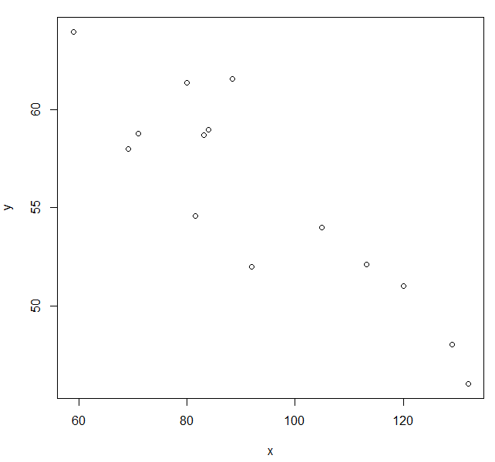
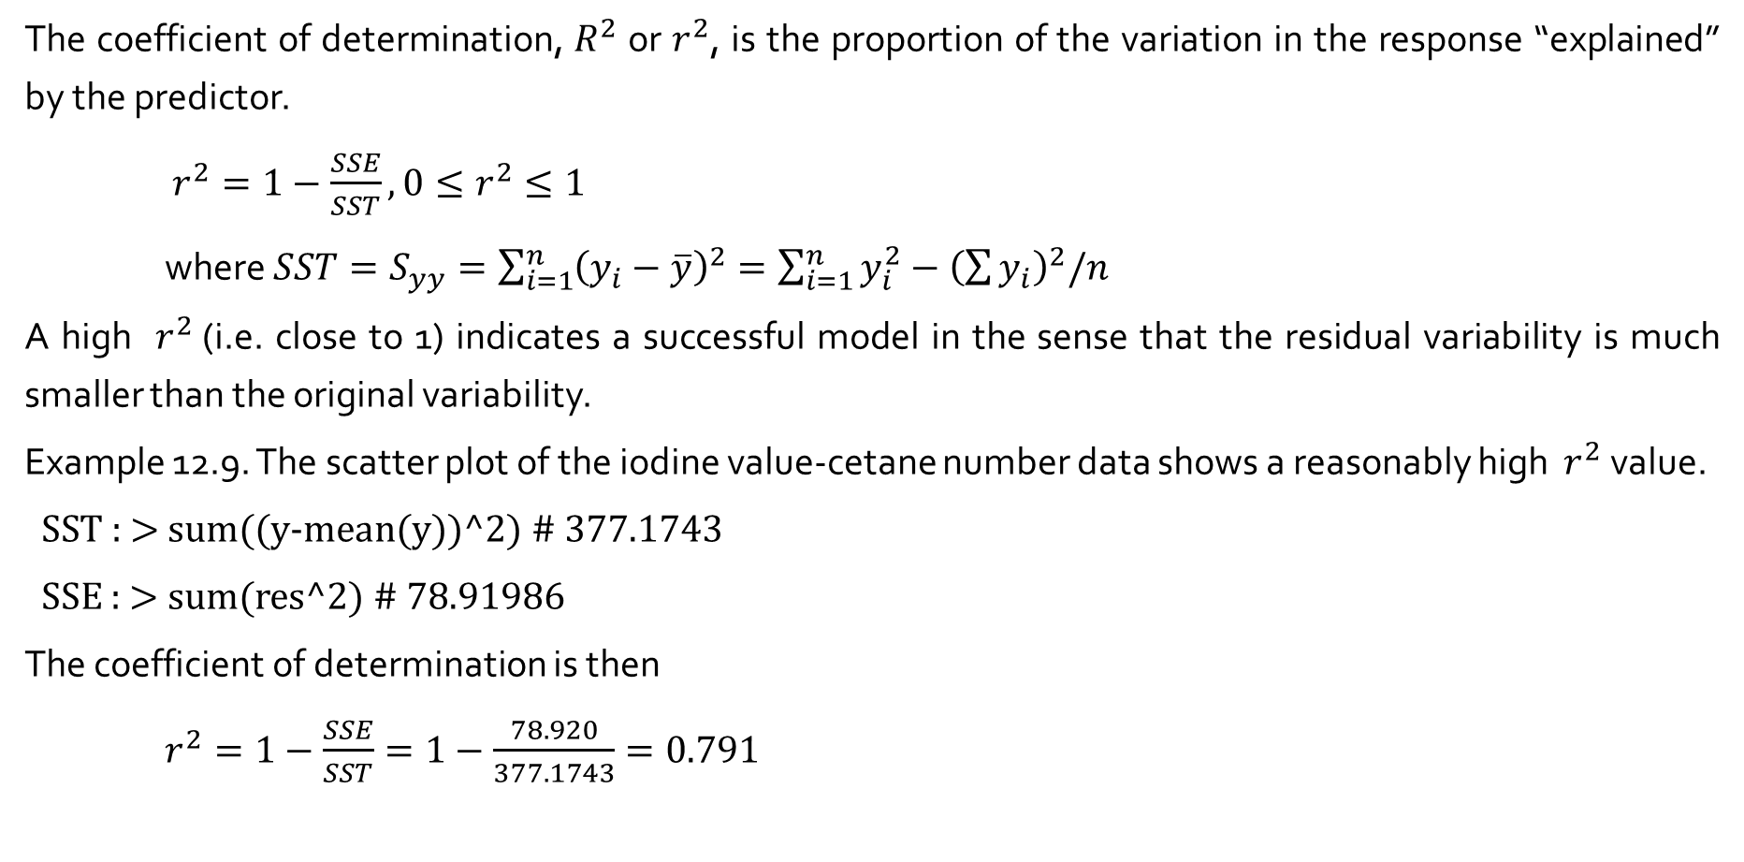
Coefficient of determination
The coefficient of determination, $R^{2}$ or $r^{2}$, is the proportion of the variation in the response “explained” by the predictor.
$r^{2}=1−\frac{SSE}{SST}, 0≤r^{2}≤1$
where $SST=S_{yy}=\sum_{i=1}^{n}{{\left(y_{i}−\overline{y}\right)}^{2}}=\sum_{i=1}^{n}{y_{i}^{2}}−{\left(\sum{y_{i}}\right)}^{2}/n$
A high $r^{2}$(i.e. close to 1) indicates a successful model in the sense that the residual variability is much smaller than the original variability.
Example 12.9. The scatter plot of the iodine value-cetane number data shows a reasonably high $r^{2}$ value.
SST : > sum((y-mean(y))^2) # 377.1743
SSE : > sum(res^2) # 78.91986
The coefficient of determination is then
$r^{2}=1−\frac{SSE}{SST}=1−\frac{78.920}{377.1743}=0.791$

Slide 4
Steps in the analysis
> f <- lm(y ~ x)
> summary(f)
Call:
lm(formula = y ~ x)
Residuals:
Min 1Q Median 3Q Max
-3.9488 -1.5665 0.6817 1.0846 4.8974
Coefficients:
Estimate Std. Error t value Pr(>|t|)
(Intercept) 75.21243 2.98363 25.208 9.22e-12 ***
x -0.20939 0.03109 -6.734 2.09e-05 ***
---
Signif. codes: 0 ‘***’ 0.001 ‘**’ 0.01 ‘*’ 0.05 ‘.’ 0.1 ‘ ’ 1
Residual standard error: 2.564 on 12 degrees of freedom
Multiple R-squared: 0.7908, Adjusted R-squared: 0.7733
F-statistic: 45.35 on 1 and 12 DF, p-value: 2.091e-05

